Slide 1
Data to solve problem

Slide 2
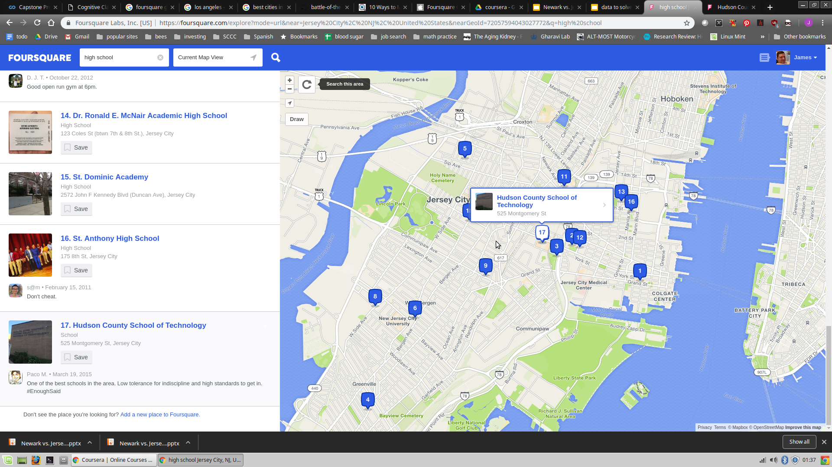
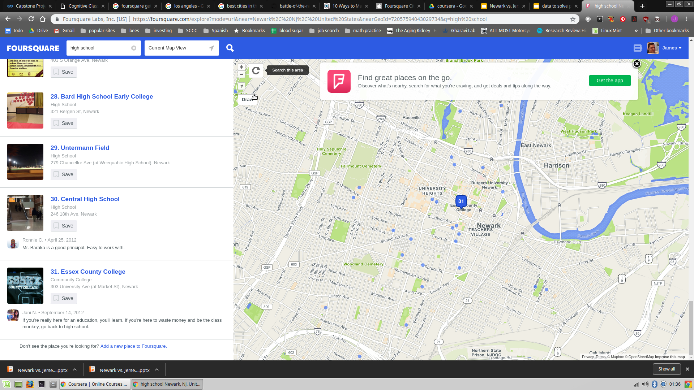
TOTAL NUMBER High Schools

Slide 3
I plan on coding the total count. One will win. As mentioned earlier, I will try to see if I can do other searches to make it more interesting.

Slide 4
Data to be used on Newark:
https://github.com/jim-cassidy/battle-of-the-neighborhoods/blob/master/data%20newark

